Slide 1
Applications of Data Analytics in Manufacturing
Minh Nguyen, PhD.
Rolls Royce Digital.

Slide 2
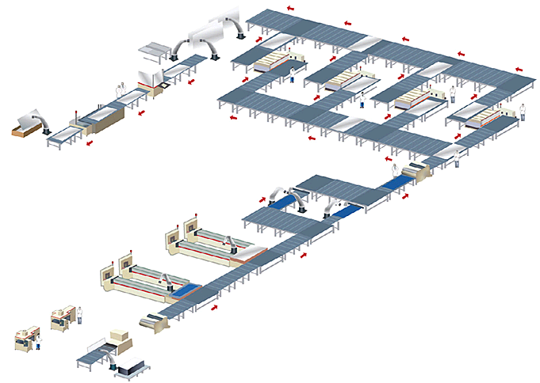
Overview of Production Line
Event system: recipe changes, tool maintenance activities (PM), human actions.
Measurement system: deviation quality gates, yield output.
Investigation system: find quality deviation root causes
Tracking: waferID, toolID,
events.
August 24, 2016
| Micron Confidential

Slide 3
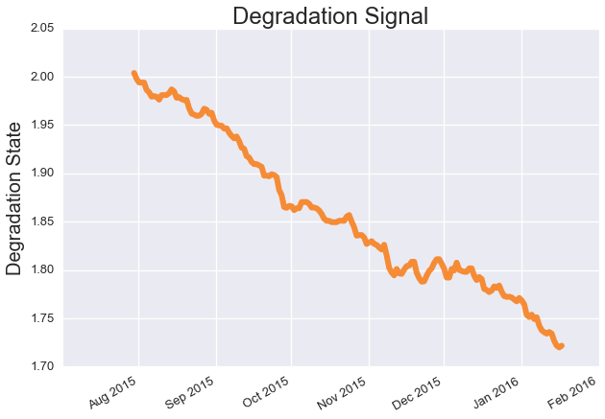
Event System Solution: Predictive Maintenance
Predict when the tool would go to an unacceptable condition.
Mainly based on monitoring system, but event data also influences the result.
August 24, 2016
| Micron Confidential

Slide 4
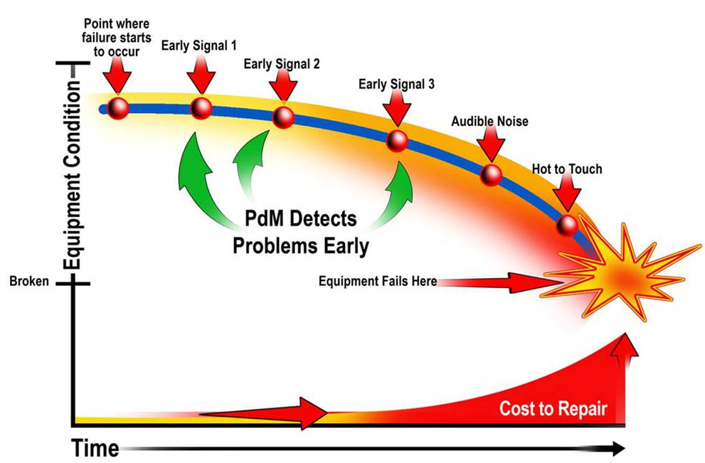
Predictive Maintenance
Predict when a tool would go bad.
Sources: www.maintenance.org
August 24, 2016
| Micron Confidential

Slide 5
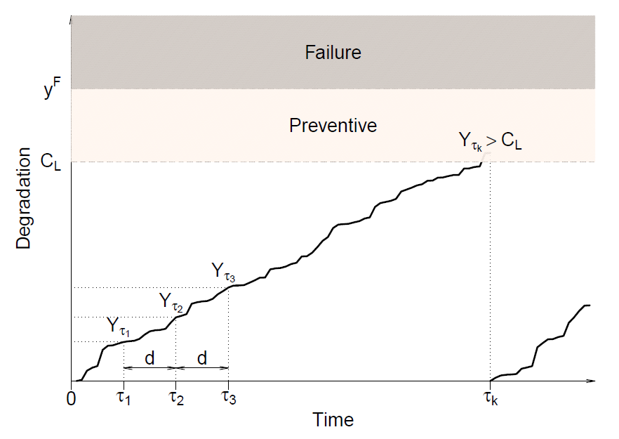
Maintenance Model
Terminologies:
Degradation signal Y:
Monotonically increasing or decreasing
Recover after CM/PM
Failure Limit y^{F}:
Tool fails when degradation signal hits
Control Limit C_{L}:
Perform PM when degradation signal hits
August 24, 2016
| Micron Confidential

Slide 6
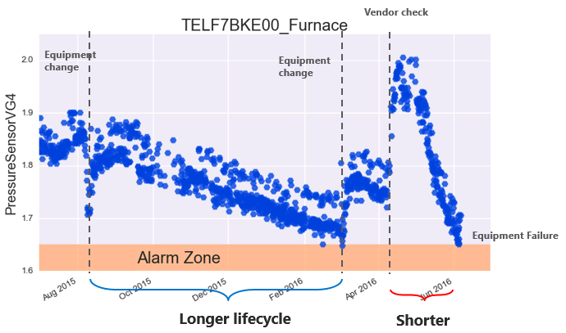
Real Scenario
August 24, 2016
| Micron Confidential

Slide 7
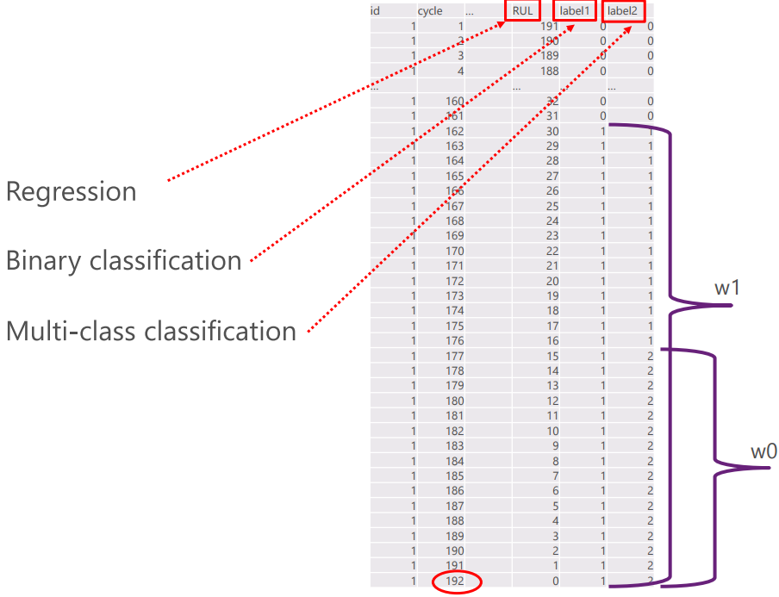
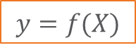
Problem Formulation
August 24, 2016
| Micron Confidential

Slide 8
Measurement Solution: Virtual Measurement
Measurement is an expensive operation, some destructive. Consequently, its sampling rate is low.
However, some monitoring systems have 100% sampling rate, either through sensors or scanning images.
August 24, 2016
| Micron Confidential

Slide 9
Virtual Measurement
Motivation: Predict low-sampled measurement using 100% sampled images.
August 24, 2016
| Micron Confidential

Slide 10
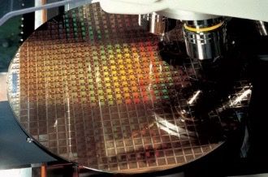
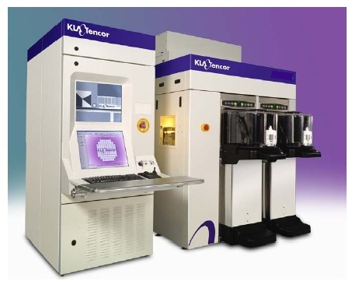
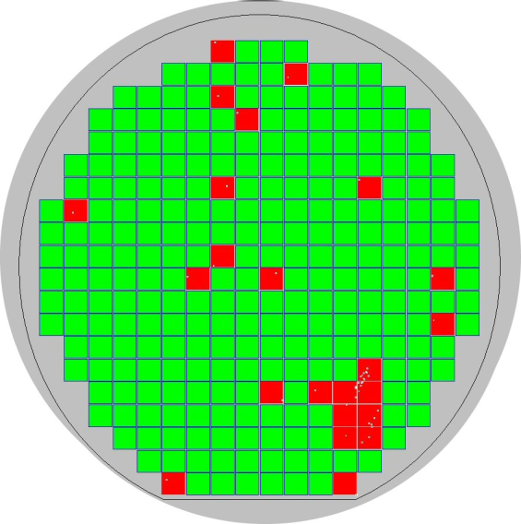
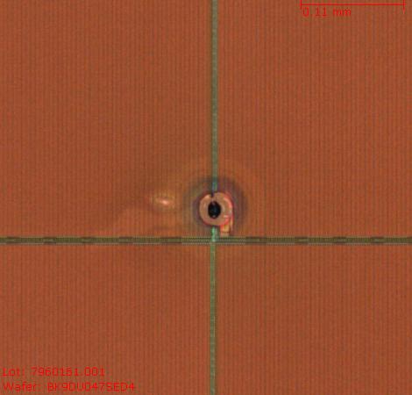
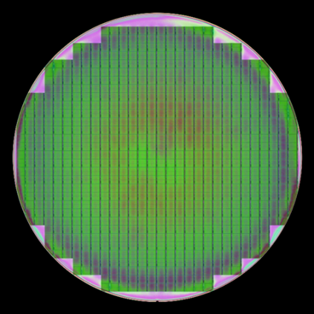
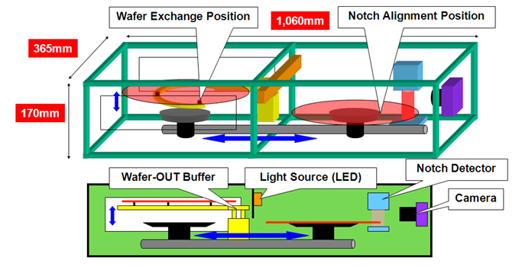
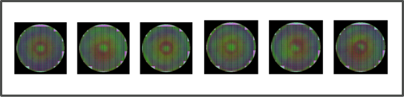
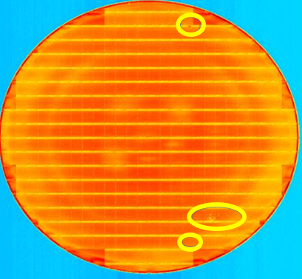
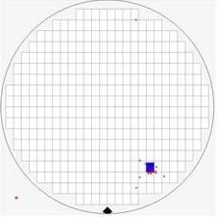
Virtual Measurement
8% lot-level
1% wafer-level sampling
Conventional
Macro Inspection
Wafer Process
RDA Inspection Tool
RDA Wafer Map and Defects
Photo WIS
1
2
100% sampling!!!
WIS RGB
Big
Data
Method
WIS RGB extracted for each pixel
VRDA analysis to flag defect
All wafers will go through multiple photo WIS scans
3
Predicted RDA defects
Actual RDA defects
100% wafer sampling →Higher visibility to detect defective wafers

Slide 11
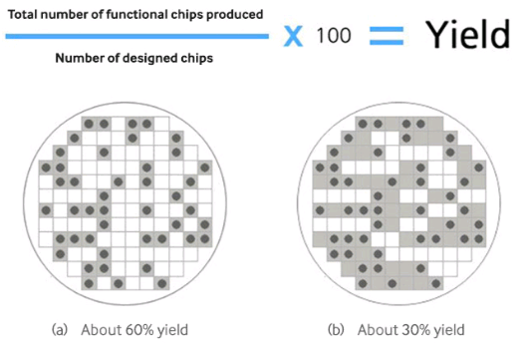
Investigation Solution: Yield Modelling
Ensure all products meet performance criteria
Have sampling rate 100%
Be used to investigate what went wrong in the event/monitoring system.
August 24, 2016
| Micron Confidential

Slide 12
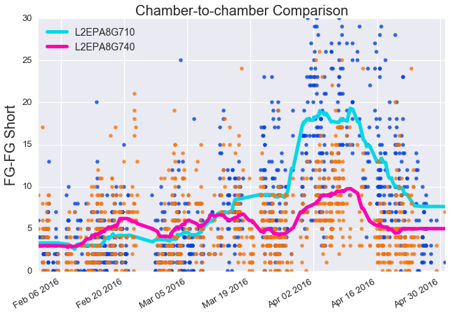
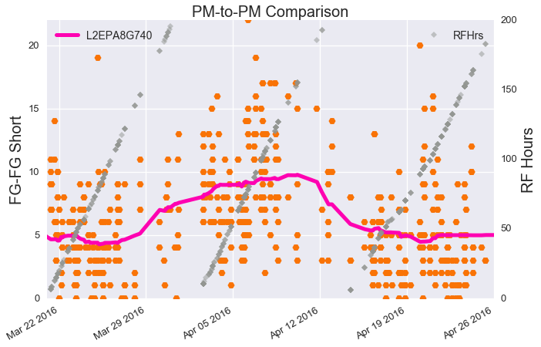
Yield Modelling
Investigate what went wrong with a bad tool
What are the root causes?
How to improve yield?
Answer from tool sensor signals
=> Bad maintenance activity.
August 24, 2016
| Micron Confidential

Slide 13
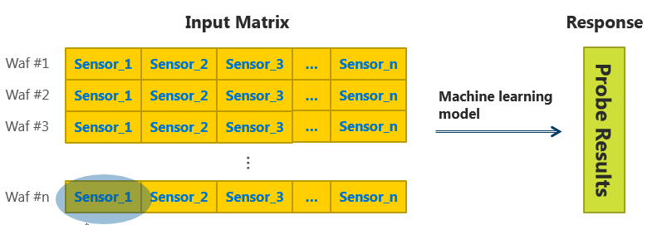
Yield Modelling
August 24, 2016
| Micron Confidential

Slide 14
Modelling with Lasso and Random Forest

Slide 15

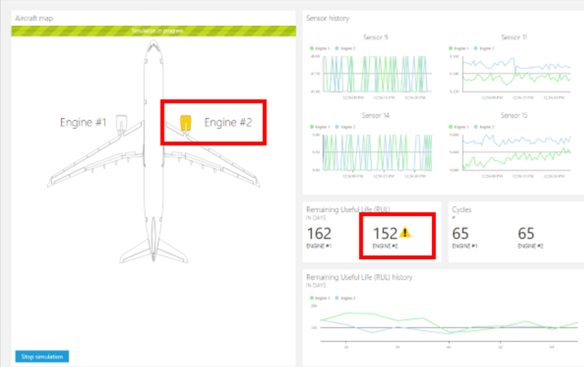
Purposes of Data Modelling
Inference
Explain the relationship among predictors and between predictors and responses.
Tell data insights and trigger investigation
Prediction
Estimate responses given predictor values in a set of unobserved samples.
August 24, 2016
| Micron Confidential

Slide 16
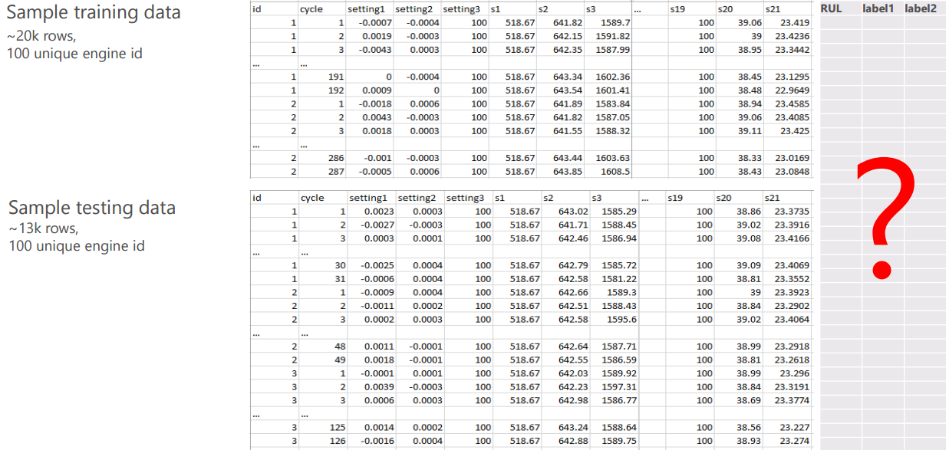
Data Structure
August 24, 2016
| Micron Confidential

Slide 17
Data Structure
August 24, 2016
| Micron Confidential

Slide 18
1. LASSO
August 24, 2016
| Micron Confidential

Slide 19
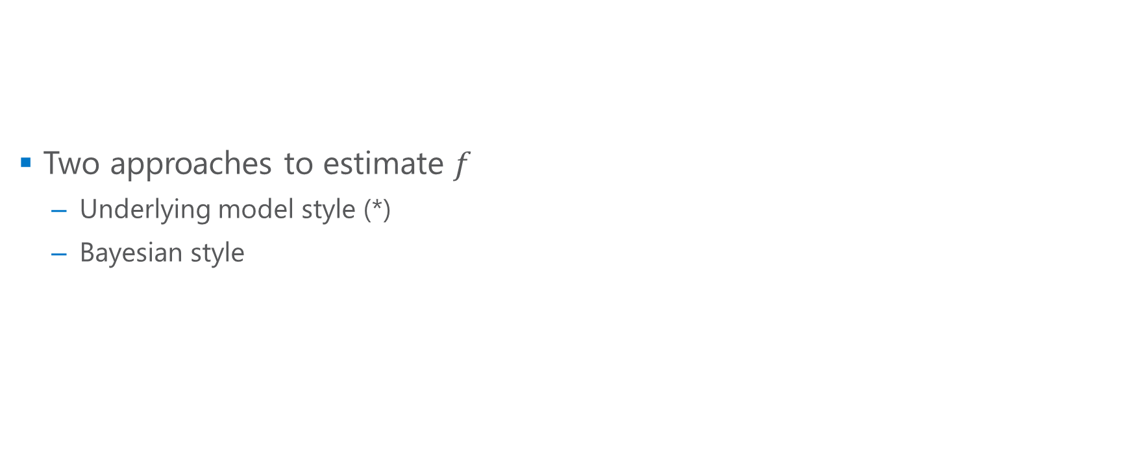
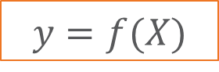

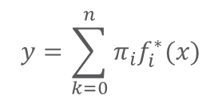
Basic Model Assumptions
Differences
One true model vs a distribution of models.
Prediction: one model vs integral model
Test error
Model complexity
Ref: Chapter 5. Deep Learning. Ian Goodfellow, Yoshua Bengio and Aaron Courville
August 24, 2016
| Micron Confidential

Slide 20
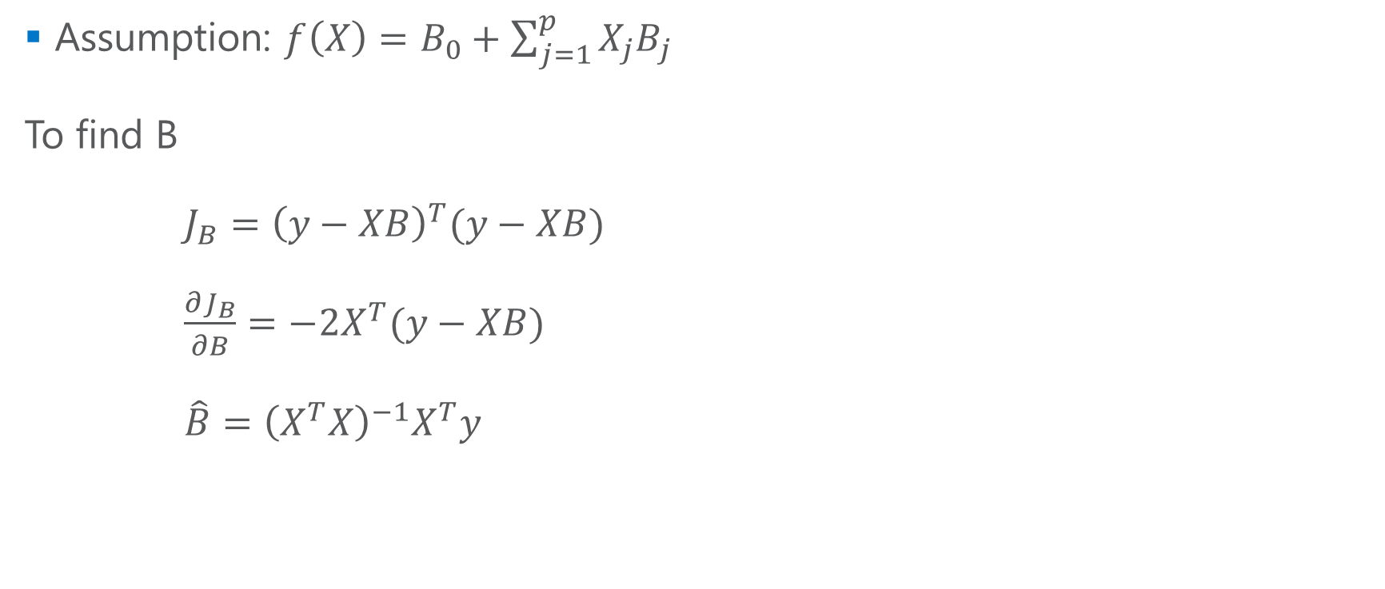
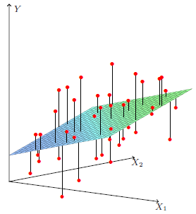
Linear Regression
August 24, 2016
| Micron Confidential

Slide 21
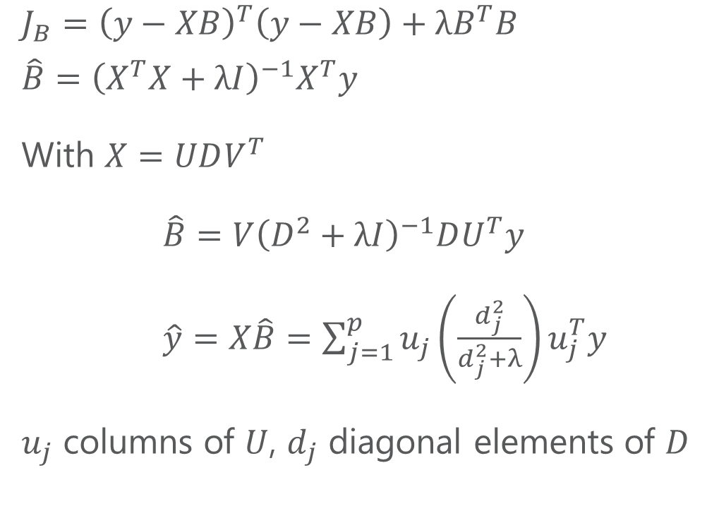
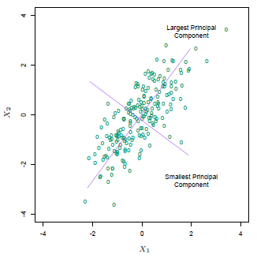
Ridge Regression
Ref: SVD Tutorial
August 24, 2016
| Micron Confidential

Slide 22
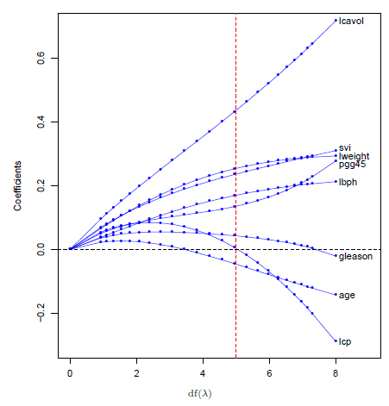
Ridge Regression
August 24, 2016
| Micron Confidential

Slide 23
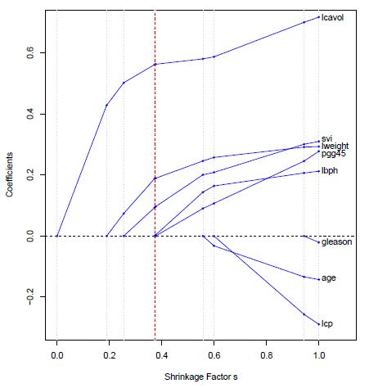
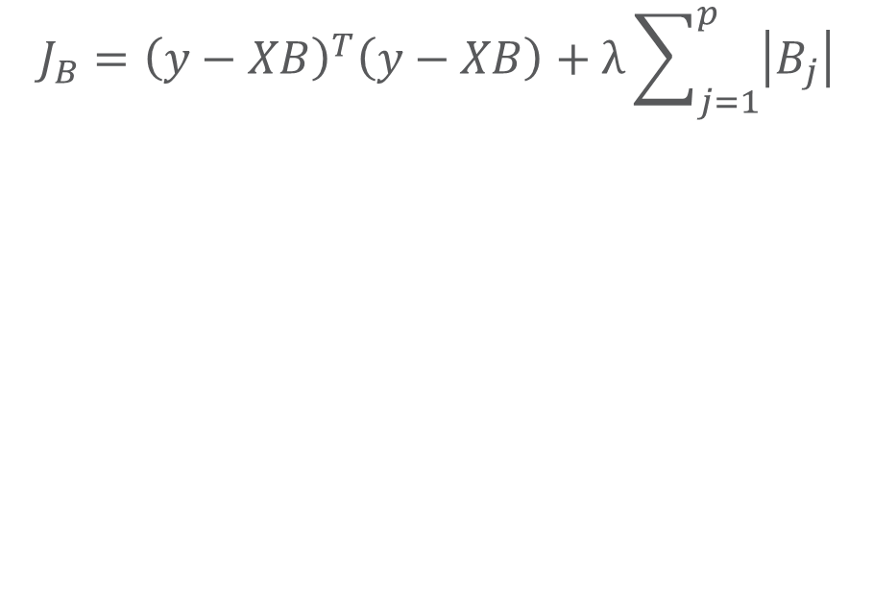
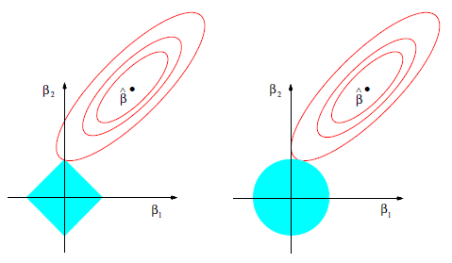
Lasso Regression
Lasso
Ridge
August 24, 2016
| Micron Confidential

Slide 24
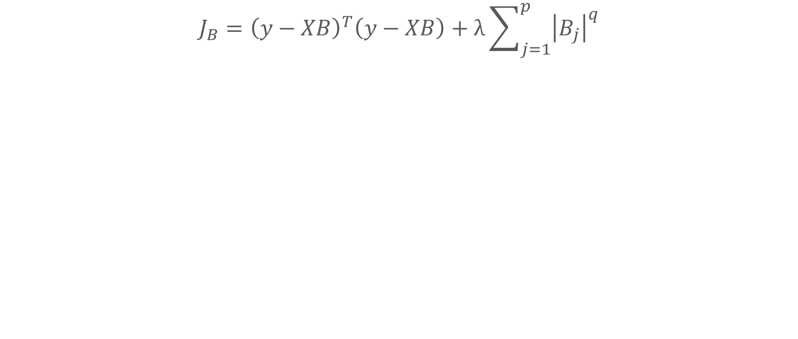
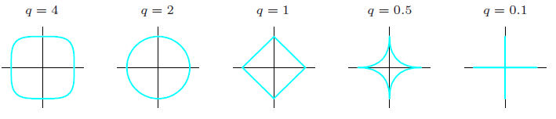
G-Formula
Elastic Net
August 24, 2016
| Micron Confidential

Slide 25
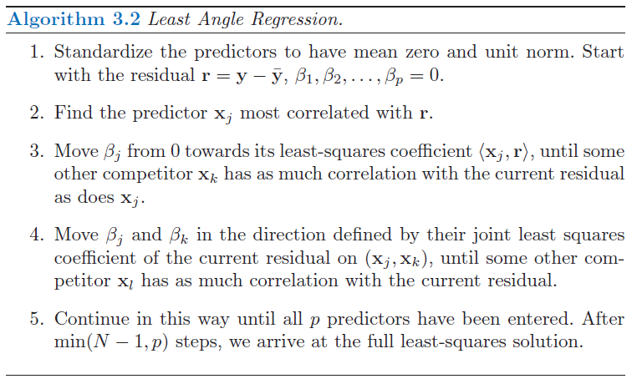
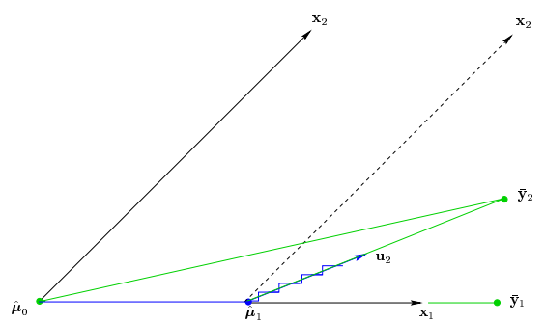
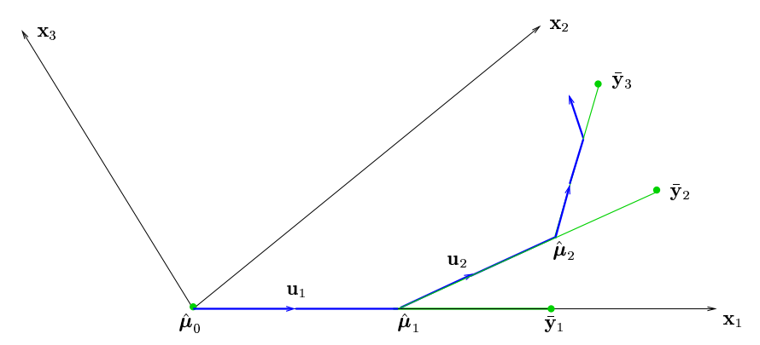
Lasso Solution – Least Angle Regression (LAR)
August 24, 2016
| Micron Confidential

Slide 26
Questions?
August 24, 2016
| Micron Confidential

Slide 27
2. RANDOM FOREST
August 24, 2016
| Micron Confidential

Slide 28
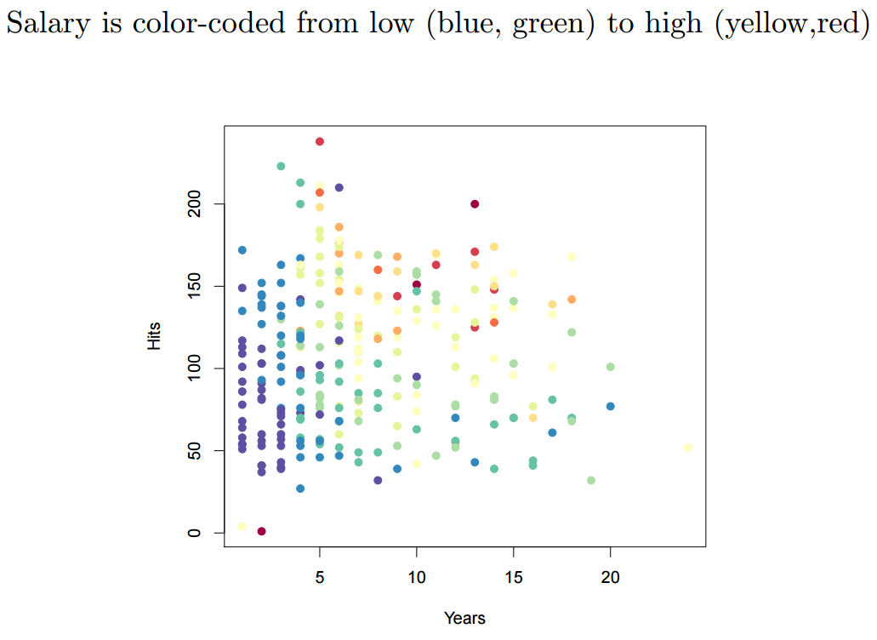
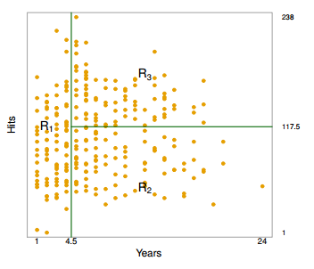
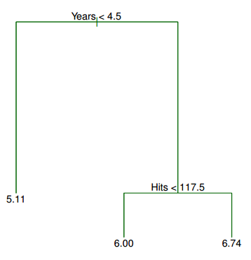
Decision Tree - Baseball Player Salary
August 24, 2016
| Micron Confidential

Slide 29
Decision Tree
An approach that is known as recursive binary splitting
Top-down,
Greedy
Predict the response for a given test observation using the mean of the training observations in the region
August 24, 2016
| Micron Confidential

Slide 30
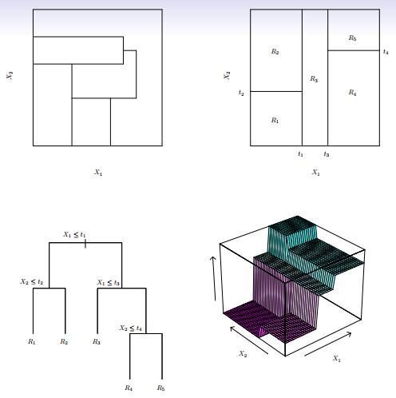
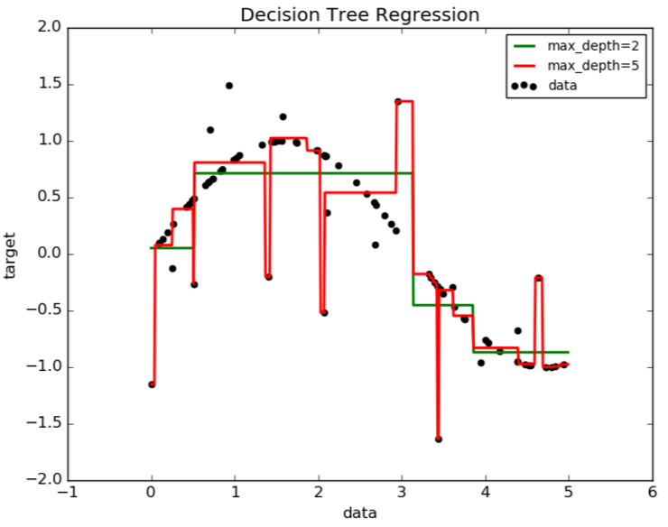
Tree Complexity and Overfitting
Simple Tree
Complex Tree
August 24, 2016
| Micron Confidential

Slide 31
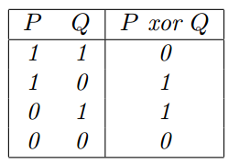


Tree Pruning
Motivation: Simple tree is too biased. Complex tree is overfitting.
Naïve solution: grow the tree only so long as the decrease in the Residual-Sum-of-Square due to each split exceeds some (high) threshold.
Result in smaller trees, but is too short-sighted: a seemingly worthless split early on in the tree might be followed by a very good split
XOR
Error not
reduced
But it WILL
be reduced
August 24, 2016
| Micron Confidential

Slide 32
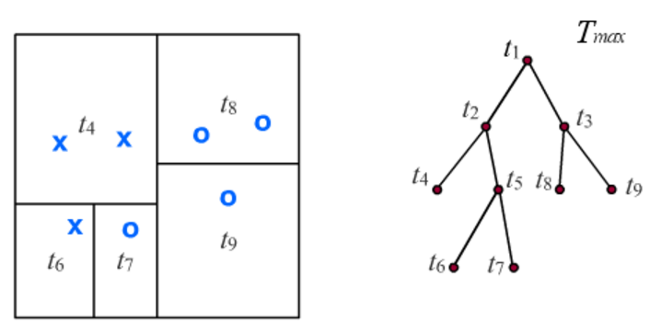
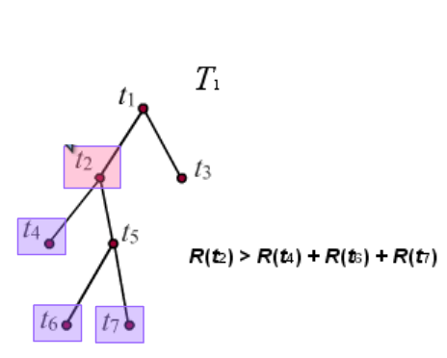
Tree Pruning
Which split can you safely remove?
Motivation: Simple tree is too biased. Complex tree is overfitting.
Better solution: grow a large tree, then merge back nodes to obtain a smaller tree of the right size link
0.25 > 0 + 0 + 0
August 24, 2016
| Micron Confidential

Slide 33
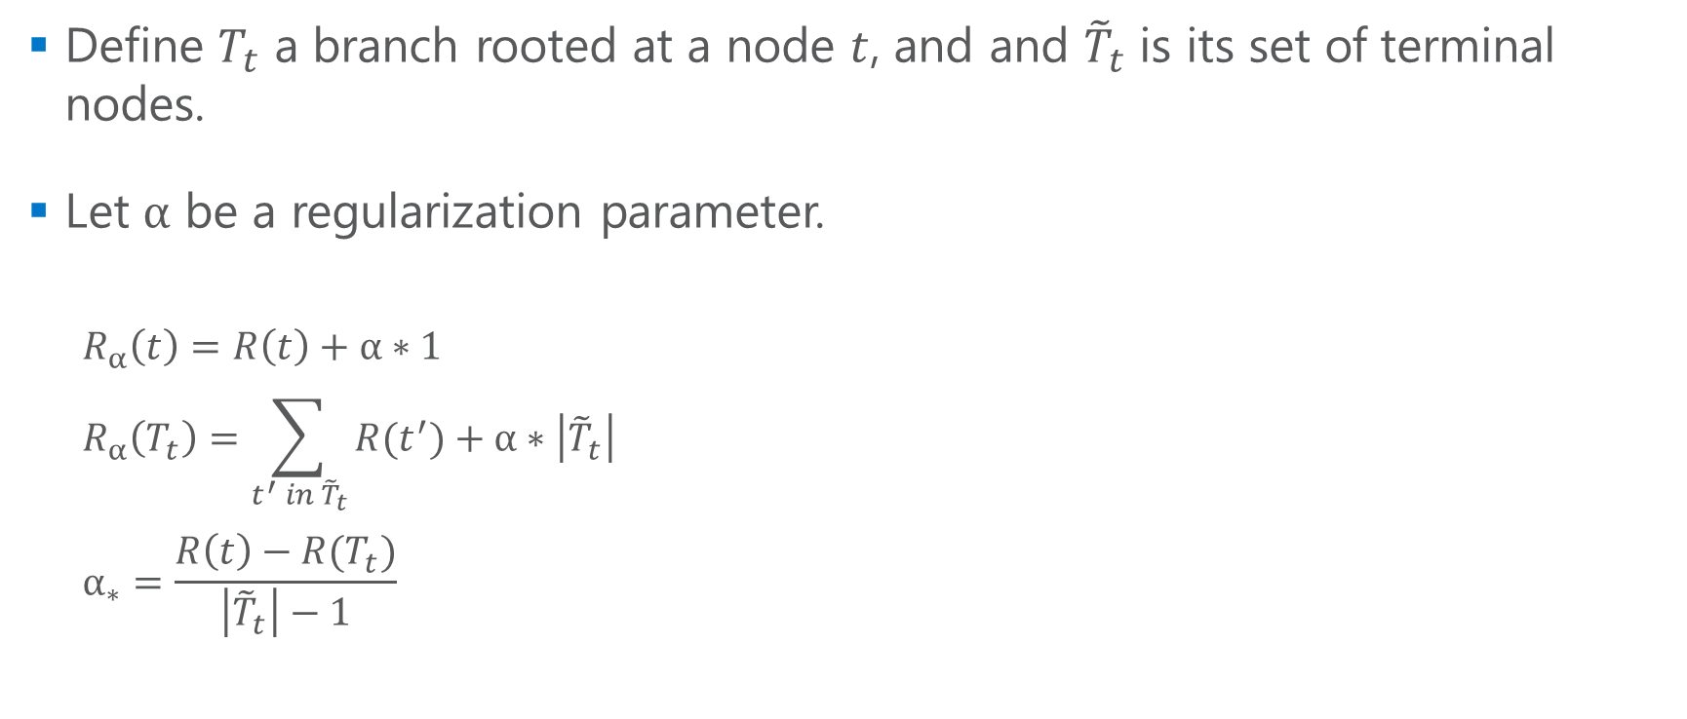
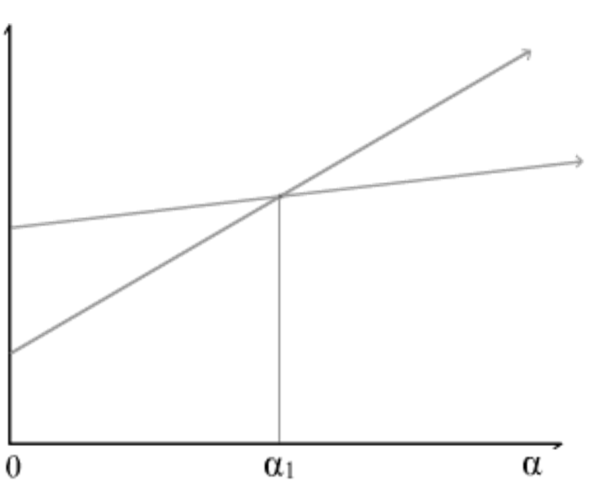
Cost complexity pruning (or Weakest link pruning)
*
August 24, 2016
| Micron Confidential

Slide 34
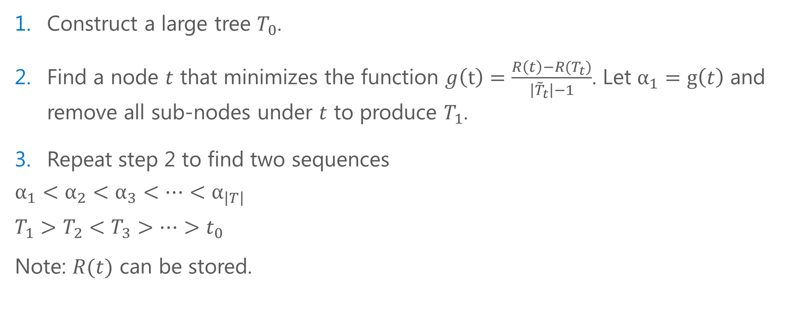
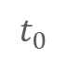
Cost complexity pruning (or Weakest link pruning)
August 24, 2016
| Micron Confidential

Slide 35


Single Decision Tree
August 24, 2016
| Micron Confidential

Slide 36




Bagging
August 24, 2016
| Micron Confidential

Slide 37
Bagging – Prediction
Averaging predictions from multiple trees, each is constructed on one part of a training data set. Famous method: Bootstrap (sampling with replacement).
August 24, 2016
| Micron Confidential

Slide 38









Bagging – Variable Importance
At each tree
Sum-up
.
.
.
August 24, 2016
| Micron Confidential

Slide 39




Random Forest
August 24, 2016
| Micron Confidential

Slide 40

Random Forest
Randomization
Bootstrap samples
Feature subsets are different for these trees
August 24, 2016
| Micron Confidential

